Slide 1

Employee Attrition Prediction System
Using Human Resource and Workplace Analytics to proactively identify resignation risk, reduce talent loss, and strengthen workforce planning through machine learning.
HR ANALYTICS
MACHINE LEARNING
WORKFORCE INTELLIGENCE

Slide 2

The Hidden Cost of Employee Attrition
Voluntary turnover is one of the most expensive and disruptive challenges organizations face — yet most companies still react after the fact.
💸 Recruitment Costs
Replacing an employee costs 50–200% of their annual salary in hiring, onboarding, and training.
📉 Productivity Loss
Departing employees create knowledge gaps and reduce team output for weeks or months.
🧠 Talent Drain
High performers leaving take institutional knowledge, client relationships, and competitive advantage with them.
📊 Organizational Impact
Frequent attrition lowers morale, increases workload on remaining staff, and degrades overall performance.

Slide 3


From Reactive to Proactive: Why Data-Driven Retention
Limitations of Traditional Methods
Exit interviews, manager intuition, and annual engagement surveys identify problems too late — after resignation letters are already submitted.
Lagging Indicators
No Predictive Power
Inconsistent Decisions
Traditional signals surface only after an employee has mentally disengaged.
Manual reviews cannot process the volume of signals needed for early detection.
Human judgment varies across managers, creating bias and blind spots.

Slide 4
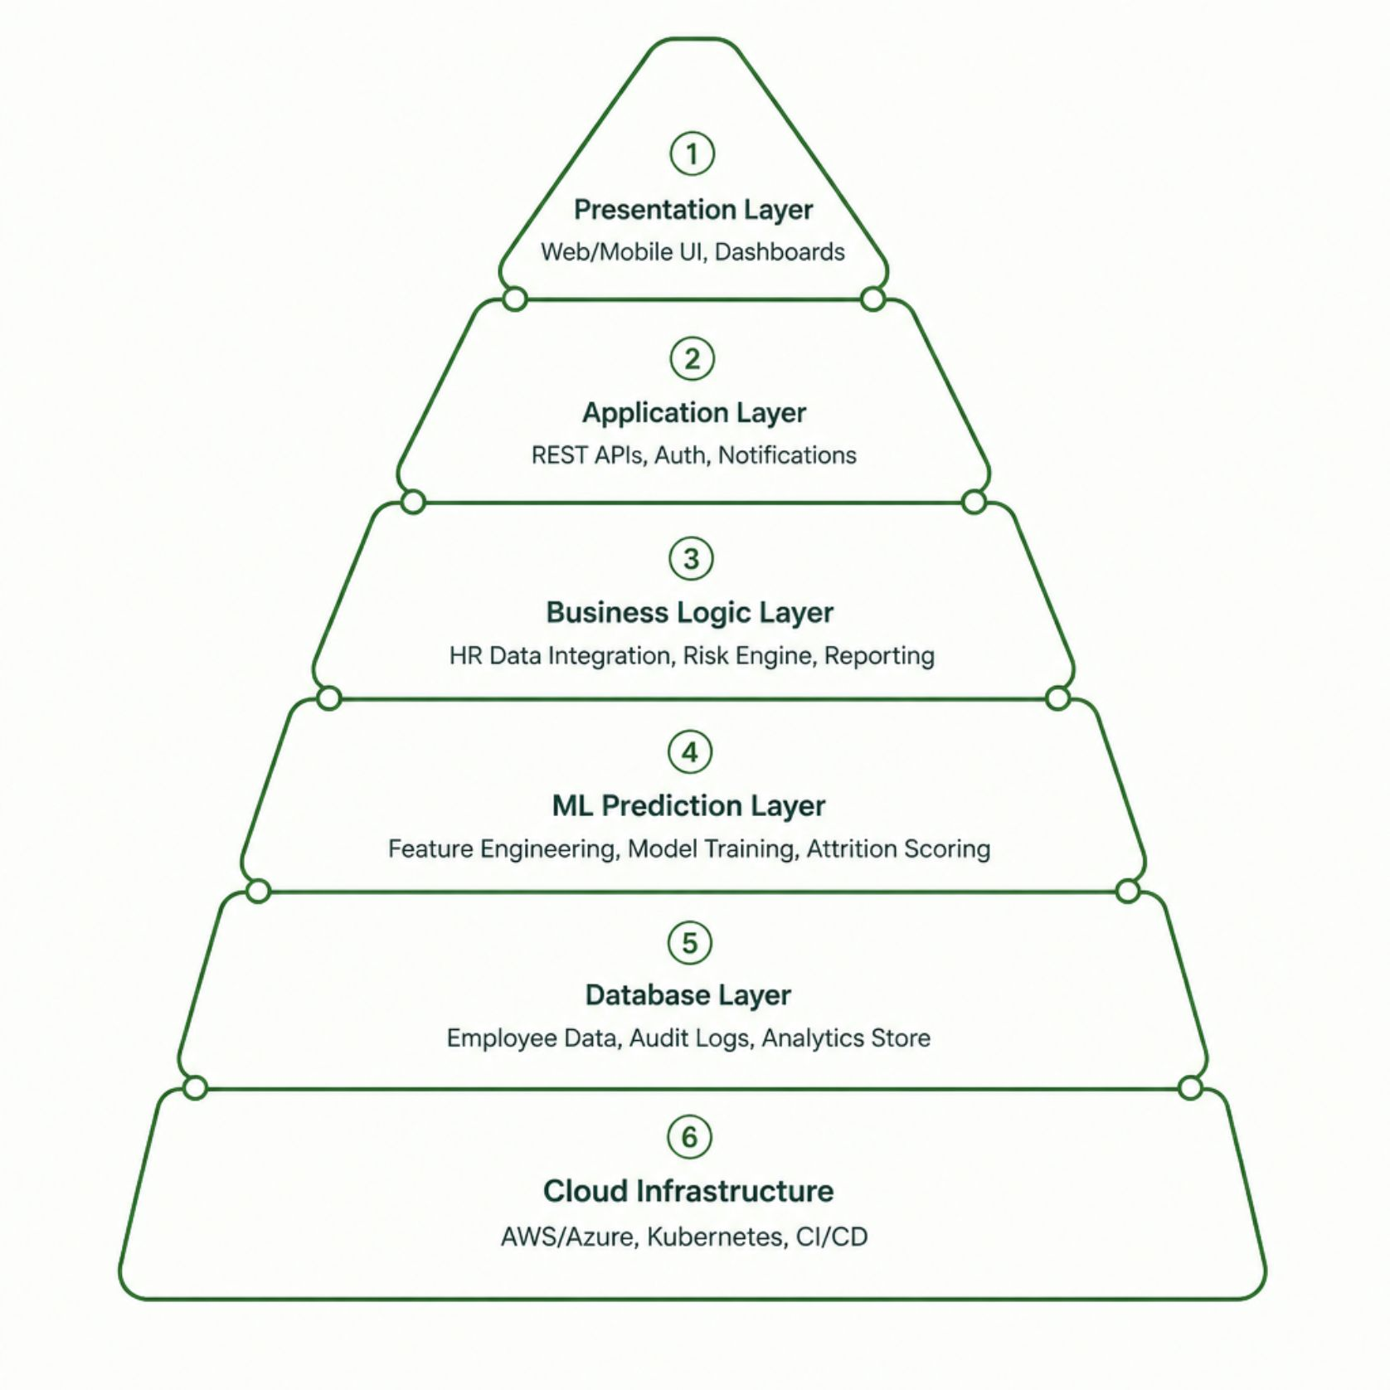
System Architecture Overview
A layered, cloud-native architecture ensures security, scalability, and real-time intelligence across the entire workforce analytics platform.
Key Architectural Principles
Microservices-based — each module independently deployable and scalable
API-first design — RESTful interfaces for HRMS and third-party integrations
Role-based access control — RBAC enforced at every layer
Cloud-native — containerized on Kubernetes for high availability
Audit-ready — full logging for compliance and traceability

Slide 5
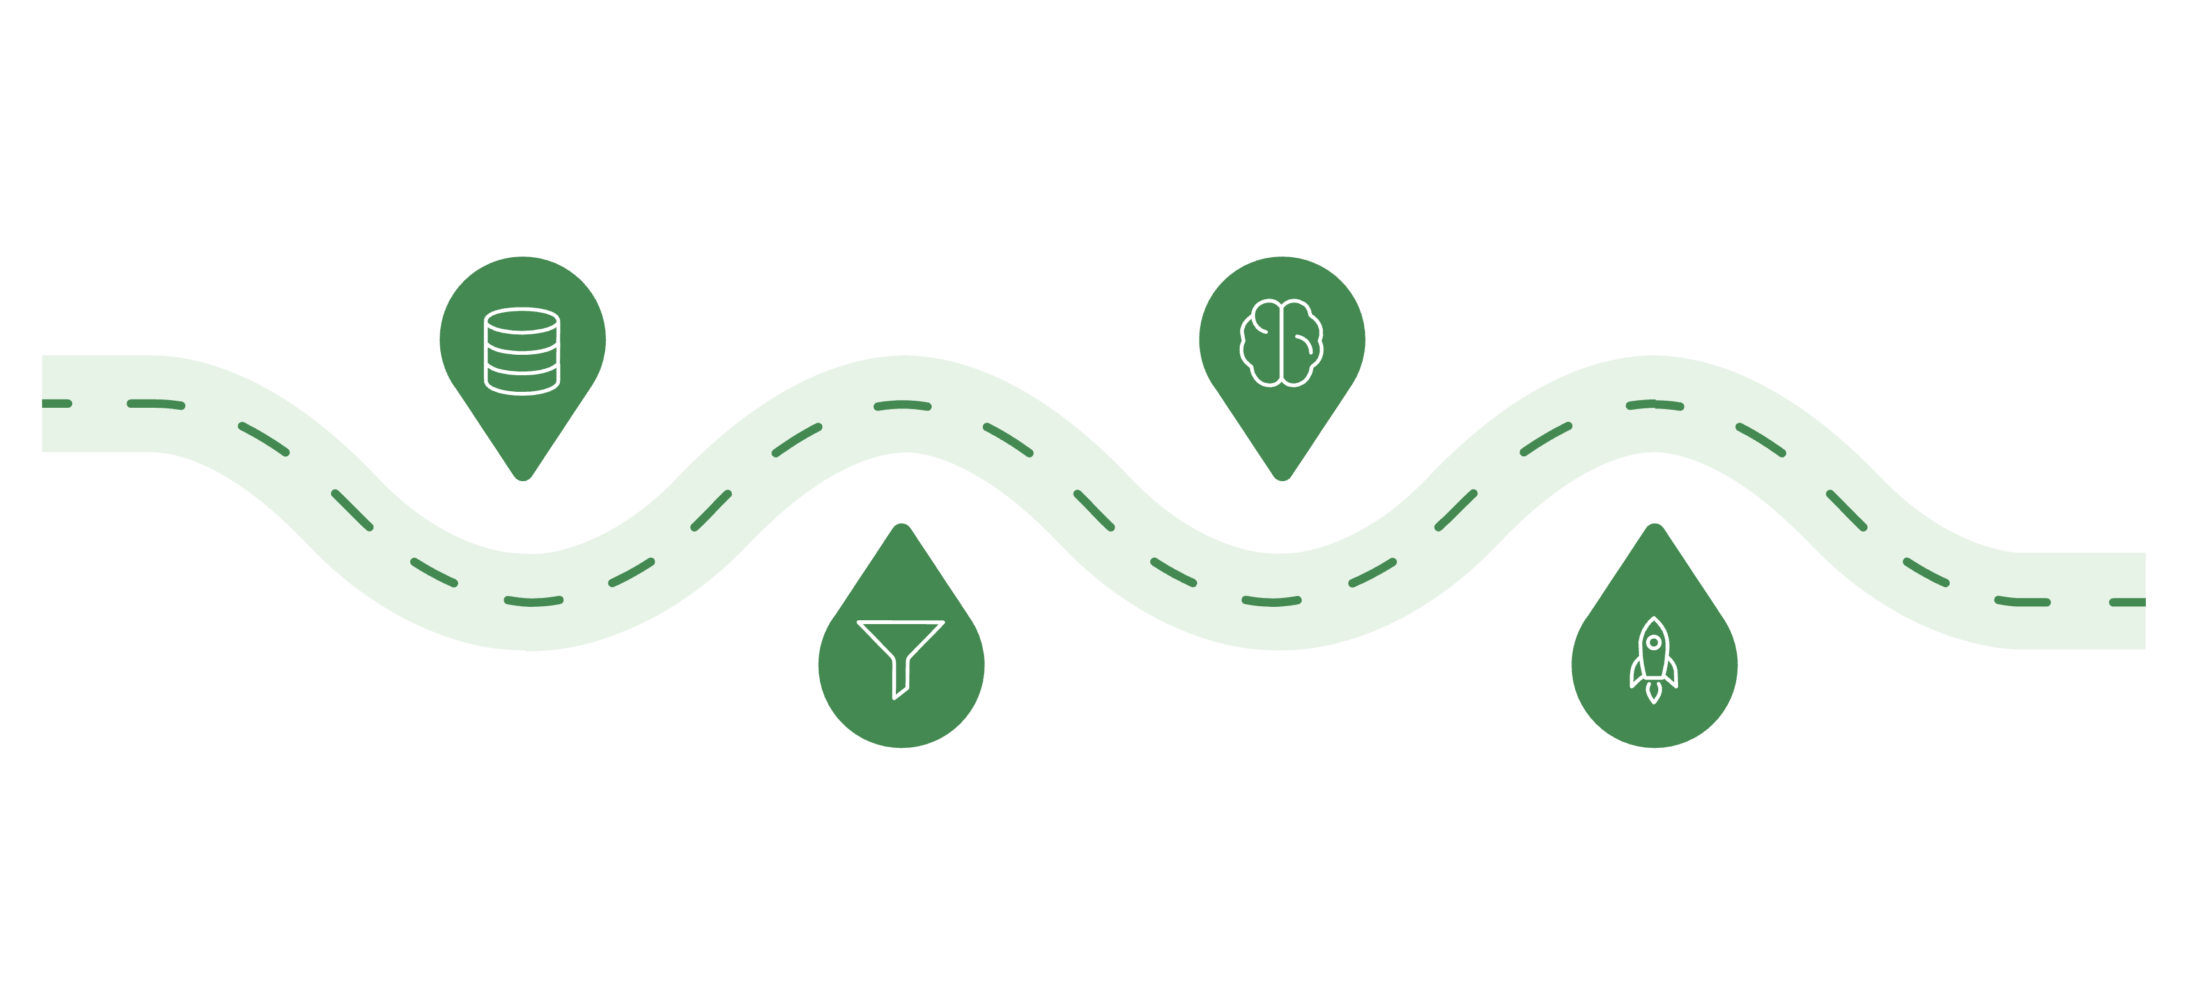

Machine Learning Prediction Pipeline
Data Collection
Model Training
Gather and validate HR signals
Select algorithms and train models
Preprocessing
Deployment
Clean and engineer predictive features
Score, monitor, and iterate continuously
The pipeline ingests structured HR data — tenure, salary, performance ratings, department, commute distance, and engagement signals — to produce calibrated attrition probability scores for every employee.
Classification Algorithms Evaluated
Evaluation Metrics
Logistic Regression & Decision Trees
Accuracy, Precision, Recall — classification performance
F1-Score & ROC-AUC — balance and discriminative power
Confusion Matrix — false positive/negative analysis
Prediction Confidence — calibrated probability scores
Baseline models for interpretability
Random Forest & Gradient Boosting
Ensemble methods for robustness
XGBoost & Neural Networks
High-performance models for production

Slide 6
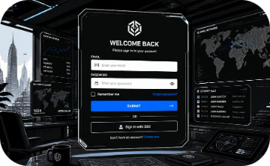
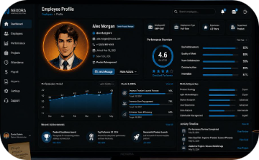

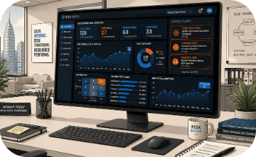
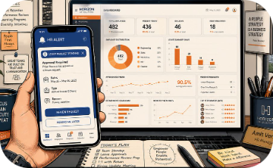
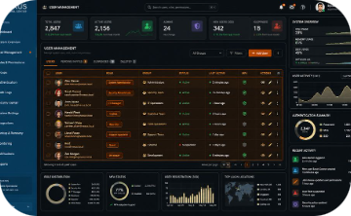
Core System Modules
Authentication & Access
Employee Profile Management
HR Data Integration
Risk Assessment Engine
Secure login, RBAC, session management, and audit logging for compliance.
Automated ingestion from HRMS, payroll, and performance systems via REST APIs.
Real-time attrition scoring with explainable feature importance for HR teams.
Centralized records including tenure, compensation, performance history, and career trajectory.
Notification & Reporting
Administration Panel
Automated alerts, scheduled reports, and intervention recommendations for managers.
System configuration, user management, model retraining triggers, and platform monitoring.

Slide 7
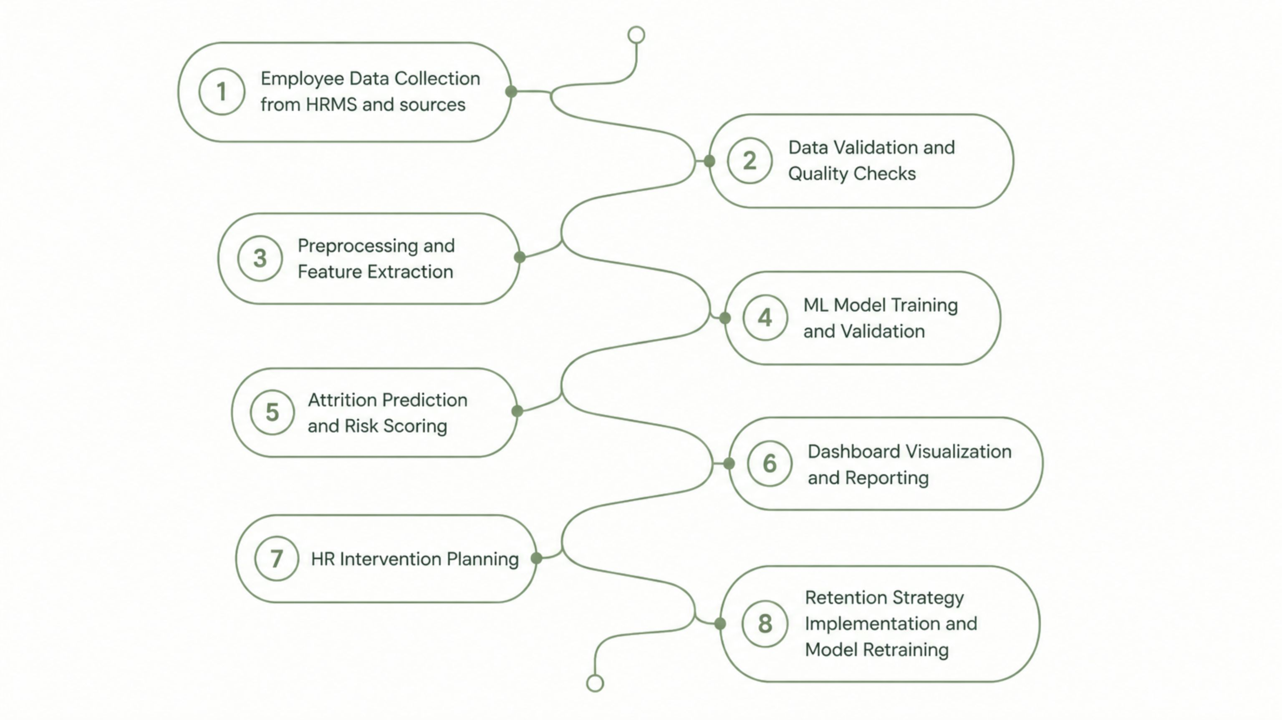
End-to-End Workflow
The workflow is continuous — model performance is monitored in production, and retraining is triggered automatically as new HR data becomes available, ensuring predictions stay accurate over time.

Slide 8
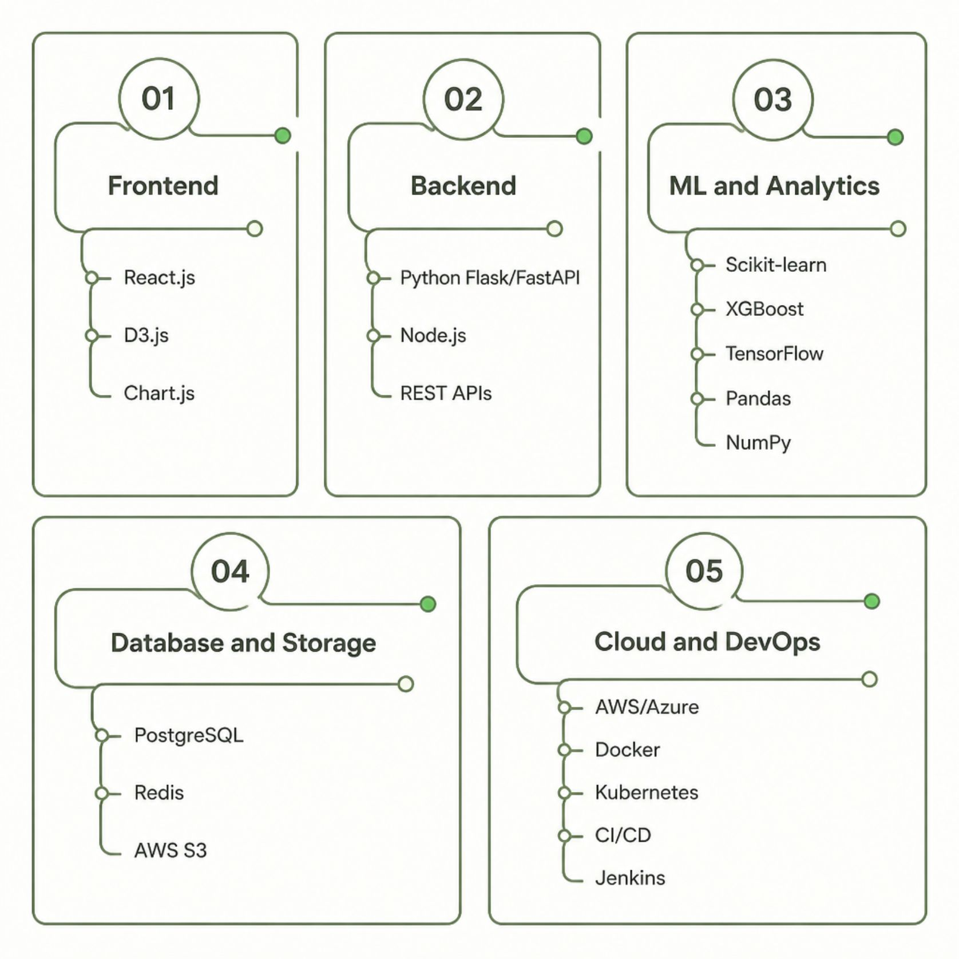

Technology Stack
Why These Technologies?
Python ecosystem — mature ML libraries and data tooling
React + D3.js — responsive, interactive dashboards
PostgreSQL + Redis — relational storage with low-latency caching
Docker + Kubernetes — containerized, auto-scaling deployment
REST APIs — seamless HRMS and third-party integration
All components are open-standards based, enabling vendor flexibility and long-term maintainability.

Slide 9





Business Impact & Real-World Applications
Early Risk Detection
Identify at-risk employees 60–90 days before potential resignation.
Reduced Recruitment Costs
Proactive retention cuts replacement spending by up to 40%.
Improved Workforce Planning
Data-driven headcount forecasts and succession planning.
Enhanced Employee Satisfaction
Timely interventions address concerns before they escalate.
Applicable across IT companies, healthcare, manufacturing, BPOs, government agencies, educational institutions, and multinational corporations.

Slide 10



Challenges, Future Roadmap & Conclusion
Implementation Challenges
Future Enhancements
Data Privacy
Explainable AI
GDPR/HIPAA-compliant encryption and anonymization
Transparent, interpretable predictions for HR stakeholders
Algorithmic Bias
Sentiment Analysis
Fairness audits and bias mitigation in model training
NLP on employee feedback and communication patterns
Imbalanced Data
HRMS Integration
SMOTE and class-weight techniques for rare attrition events
Native connectors for Workday, SAP SuccessFactors, Oracle HCM
Key Takeaway: By combining machine learning with workplace analytics, this system transforms HR from reactive to predictive — reducing attrition, cutting costs, and building a more resilient organization.

